Slide 1
Manufacturing Technology (ME461), Lecture 4
Date: 11/1/2018
Instructor: Shantanu Bhattacharya

Slide 2
Geometric Modeling
Geometric modeling is concerned with defining geometric objects using computational geometry.
The product may be defined with various geometric modeling system like a simple wireframe model, a surface model or a solid model for proper representation.
Basic computational geometric methods for defining simple entities such as curves, surfaces, and solids are needed.
Also, important are the various data transfer schemes such as Initial Graphics Exchange Specification (IGES), Product data exchange standard (PDES), and Drawing Exchange File Format (DXF).

Slide 3
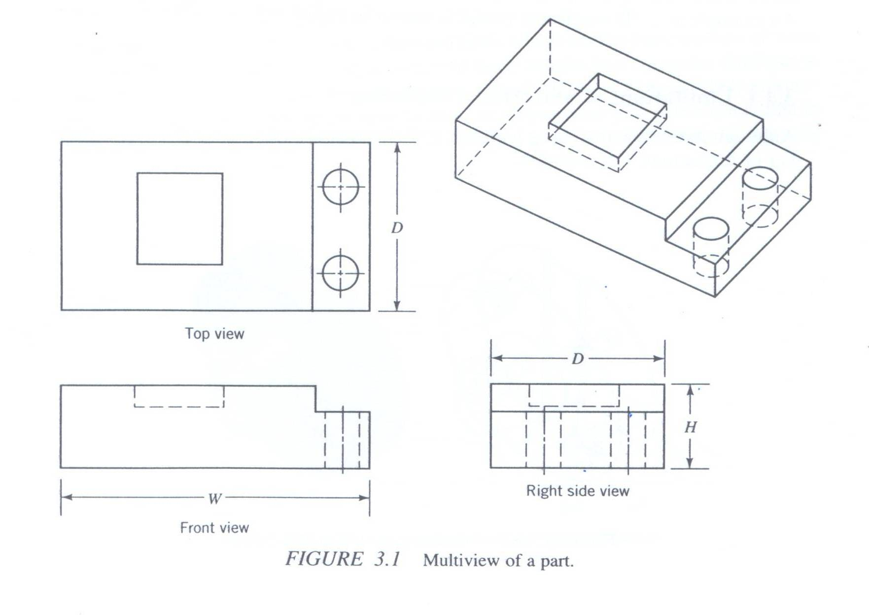
Geometric Modeling Approaches
In traditional drawing practices, an object is represented by a number of views in two dimensions. (At-least three views)
However, the basic mental functions in developing these multi-view drawings are still performed by the draftsman or designer.
Also, traditional drawing does not support subsequent applications such as finite element analysis or NC programming.
To try to overcome these problems, a number of methods have been developed over the past two decades.
In these methods, a 3D model of the part is created directly.
Then 2D view drawing can be generated by computer.

Slide 4
Wireframe Modeling
Wireframe is one of the most basic methods of geometric modeling in which the representation of entities are made by lines, arcs and circles, conics, and other types of curves utilizing light pen, keyboard, mouse and so on interactively via the CRT.
A hardcopy of the drawing in obtained by use of a printer or plotter.
Wireframe model uses points, curves (i.e., lines, circles, arcs), and so forth to define objects.
For example, a user may, with three dimensional (3D) wireframe models, enter 3D vertices, say (x,y,z) and then join the vertices to form 3D object.

Slide 5
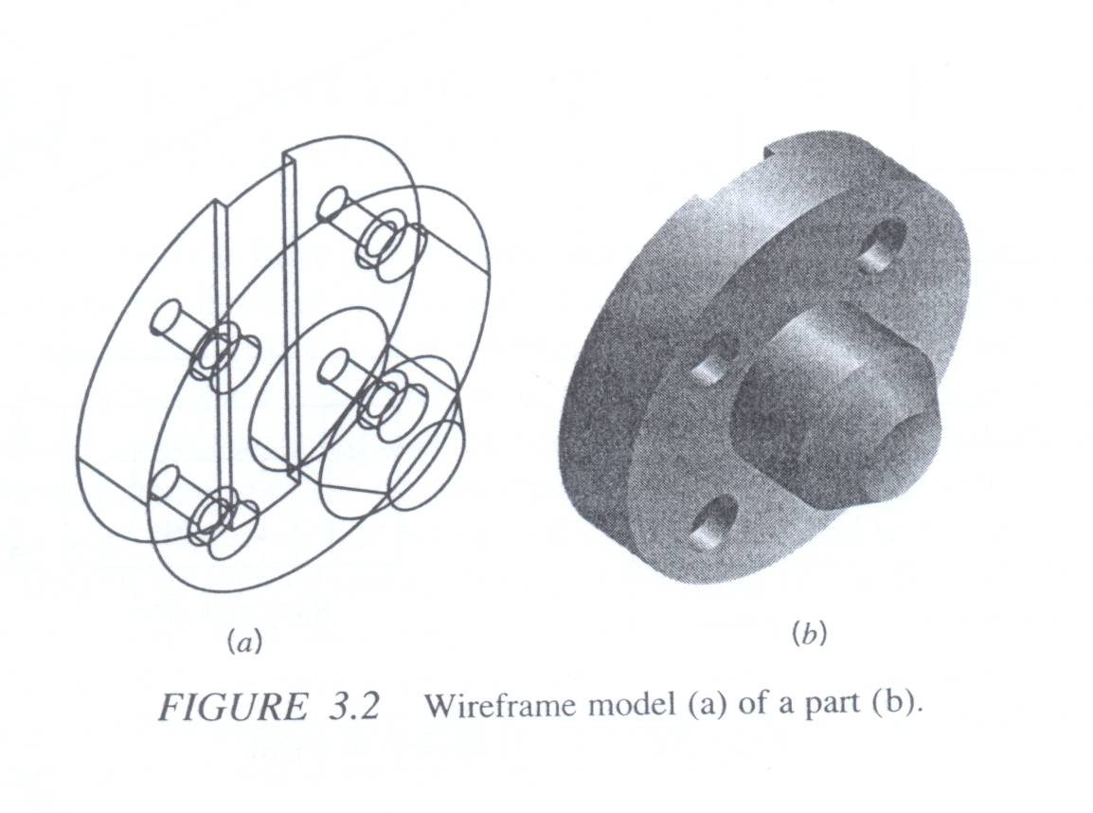
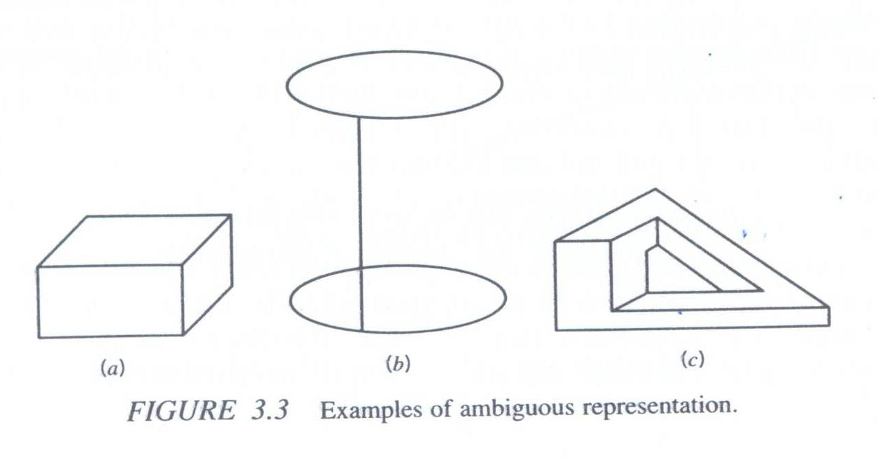
Limitations of a wireframe model
From the point of view of engineering applications, it is not possible to calculate volume and mass properties of a design. Other applications, such as NC path generation, cross-sectioning, and interference detection, also encounter problems when wireframe modeling is used.
In wireframe representation, the virtual edges (profile or silhouette) are not usually provided. For example, a cylinder is represented by three edges, that is two circles and one straight line.[Fig. 3.3(b)]
There are many wireframe representation schemes. However, ambiguous representations of real objects may be created. For example the wire frame model in the Figure 3.3(a) maybe thought of as a box or an inward corner.
The creation of wireframe models usually involves more user effort to input necessary information than that of solid models, especially for large and complex parts.
Notes:
Figure 3.3 (b) may be a boss or a hole. Figure 3.3 (c) is a nonsense object.
For example consider the creation of a 3D model of a simple cube. In the wireframe model we need to draw 12 lines, whereas with solid modeling methods a cube may be created by 12 lines, whereas with solid modeling methods a cube may be created by providing the positions of three corner points.

Slide 6
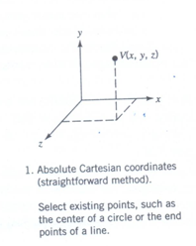
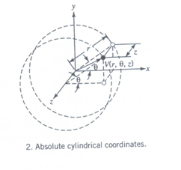
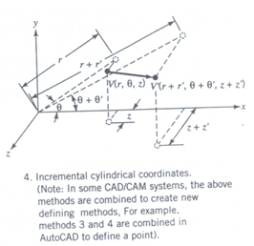
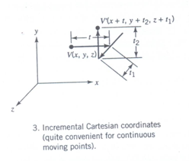
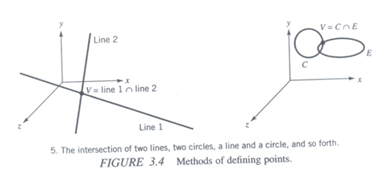
Wireframe Entities
Wireframe models consist of only points and lines, which are basic entities of these models.
Some basic geometric methods of defining points, lines, arcs, circles, ellipses and parabolas are mentioned here.
Wireframe entities are divided into two cat.-Analytic and synthetic
Methods of defining points
Notes:
Analytic entities include points, straight lines, arcs, circles, ellipses, parabolas, and hyperbolas.

Slide 7
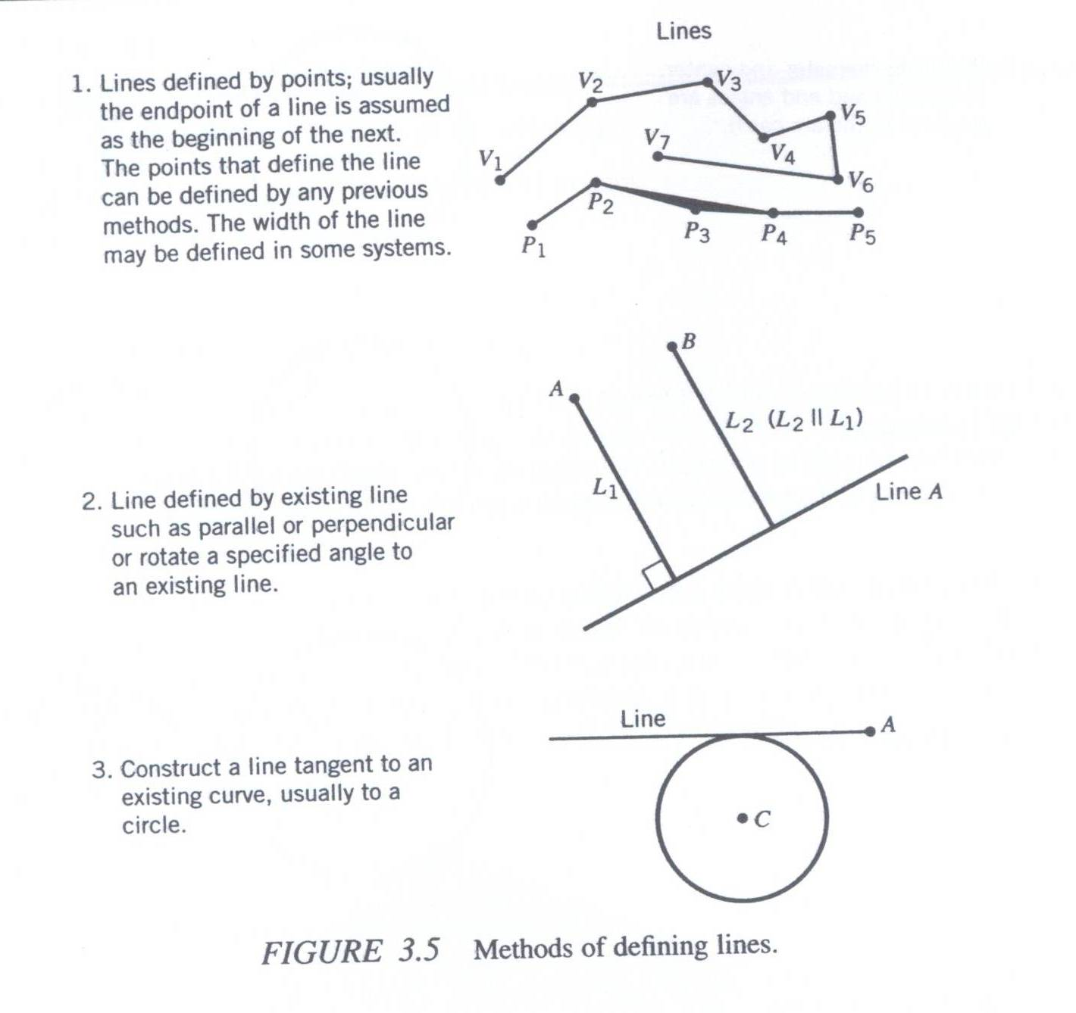
Methods of defining lines

Slide 8
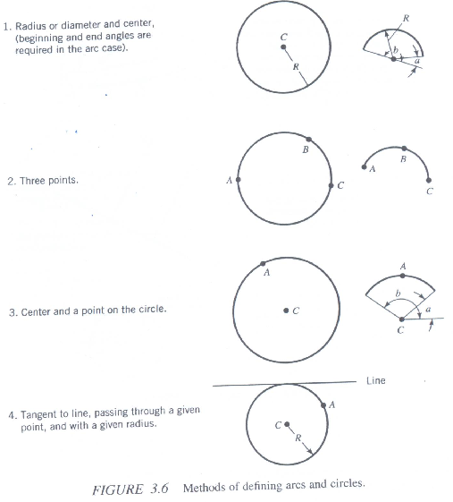
Methods of defining circles and arcs

Slide 9
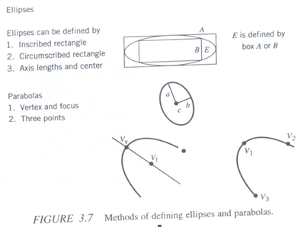
Methods of defining Ellipses and parabolas

Slide 10
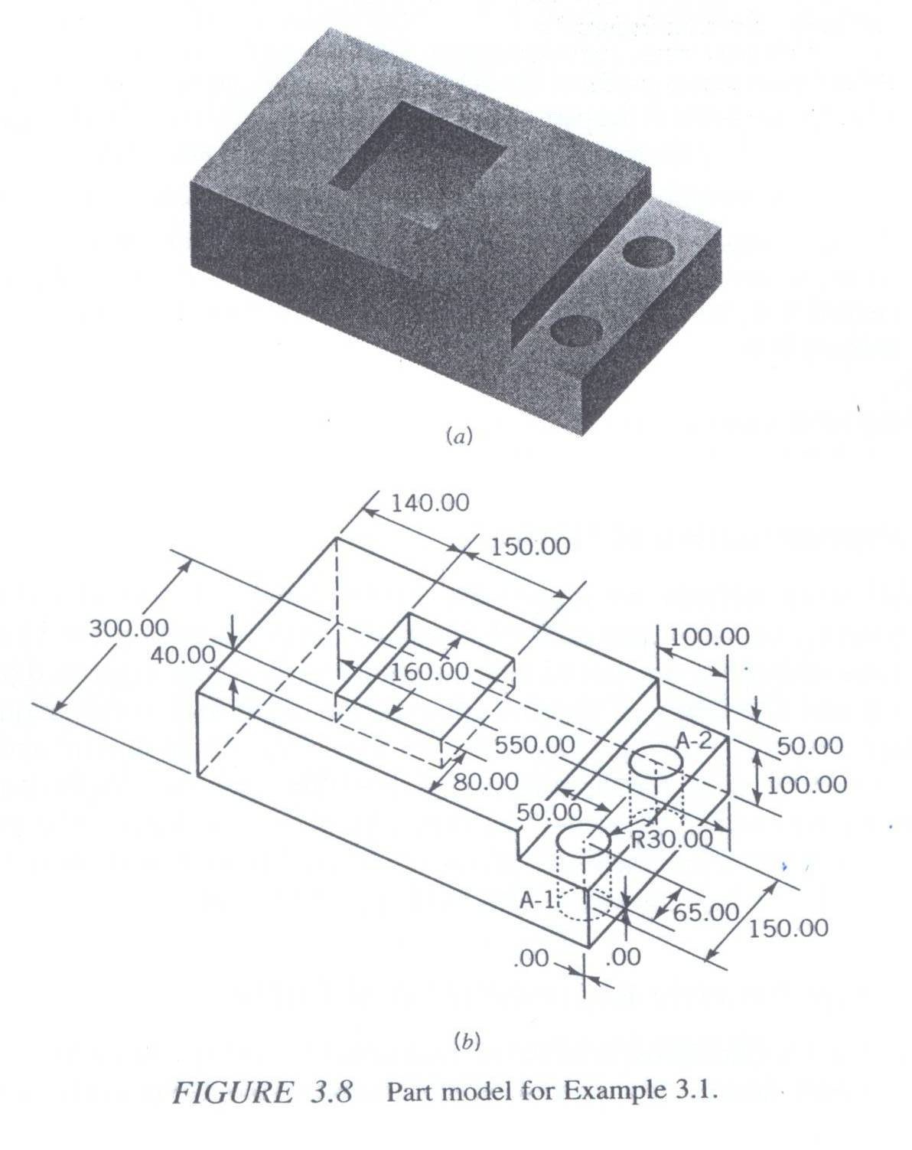
Example problem
For the object shown in figure on the left and its wireframe version create the following
The model database utilizing a CAD/CAM.
Orthographic views of the model.

Slide 11
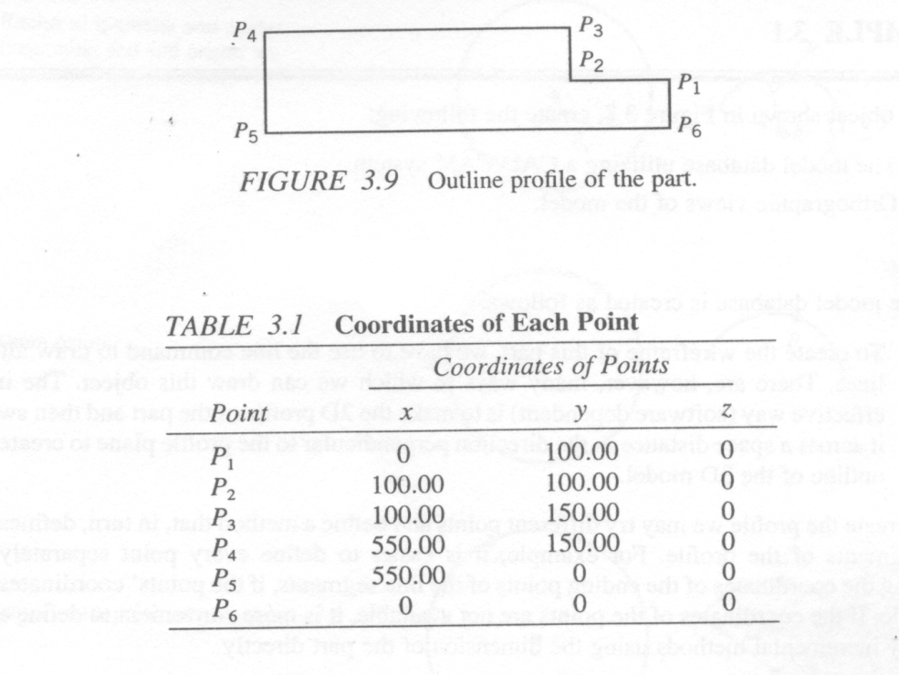
Solution
The model database is created as follows:
To create the wireframe of this part, we have to use the line command to draw all the lines. There are, however, many ways in which we can draw this object. The most effective way is to draw the 2D profile of the part and then sweep it across a space distance in the direction perpendicular to the profile plane to create the 3-D.
To create the profile we may try different points and define a method that in turn defines the line segments of the profile. In this case it is appropriate to define each point by incremental methods using the dimension of the part directly.
3. After the sweeping profile of the 3D model is created, we define the sweeping distance, which is the width of the part. When this is done, the computer creates the 3D model of the base of the part, that is, the part without the pocket and holes.
4. The procedure outlined in the earlier steps can be repeated for the pocket ad holes.
5. The final step is to create the two holes. Use of some edit commands such as array , rotate, or mirror is an efficient way to duplicate holes.

Slide 12
Representation of Curves
We now discuss the representation schemes of curves. In CAD/ CAM systems, usually thousands of curves or lines are stored and manipulated.
Mathematically curves can be represented by parametric and non-parametric equations.
Mathematically both methods are equivalent although the solution of a particular problem may be much greater with one method than the other.

Slide 13
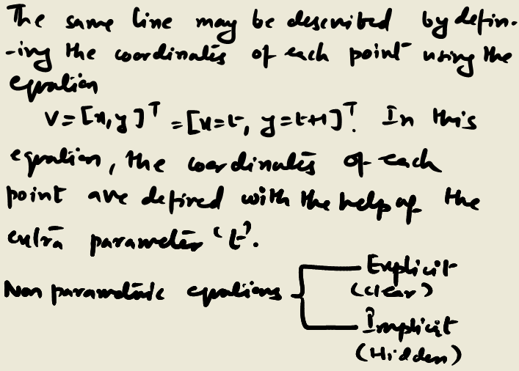
Non parametric representation of Curves.
In engineering applications both plane curves (2-D) and space curves (3-D) are used to represent the various engineering objects.
These can be defined by non-parametric equations whish we call the non-parametric representation of curves.
For example, a 2D straight line can be defined as y=x+1. This equation defines the x and y coordinates of each point without the assistance of extra parameters.
This equation is called the nonparametric equation of straight line.

Slide 14
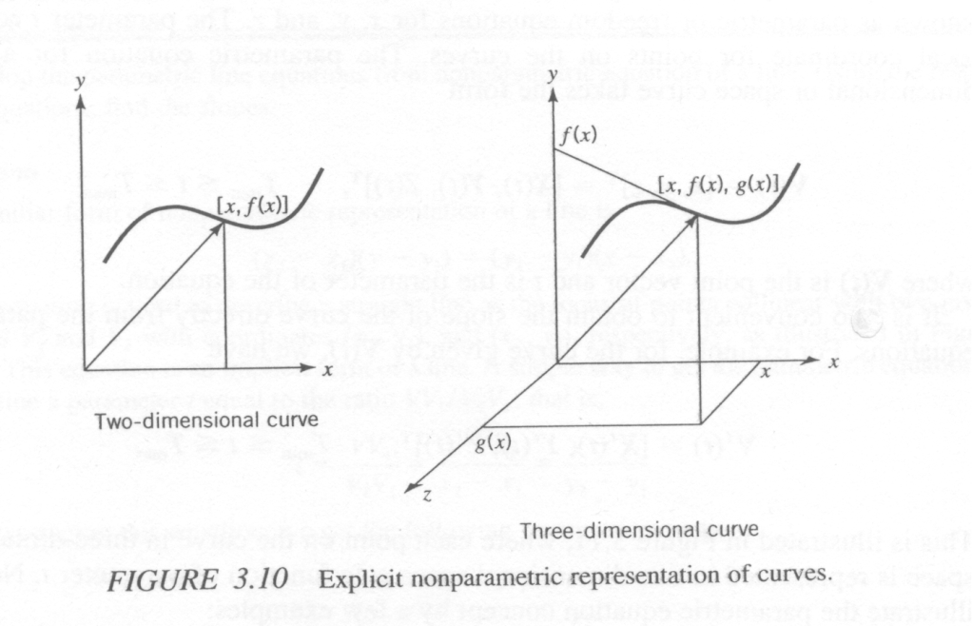
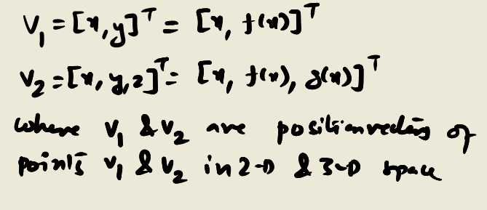
Non parametric representation (Explicit case)
Non parametric equations of curves can be further divided into explicit and implicit nonparametric equations. The explicit non parametric representation of general two dimensional and three dimensional curves taken the form:

Slide 15
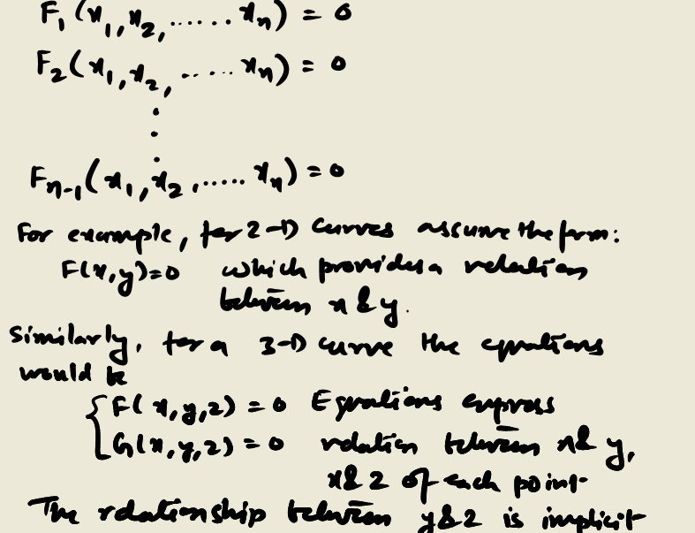
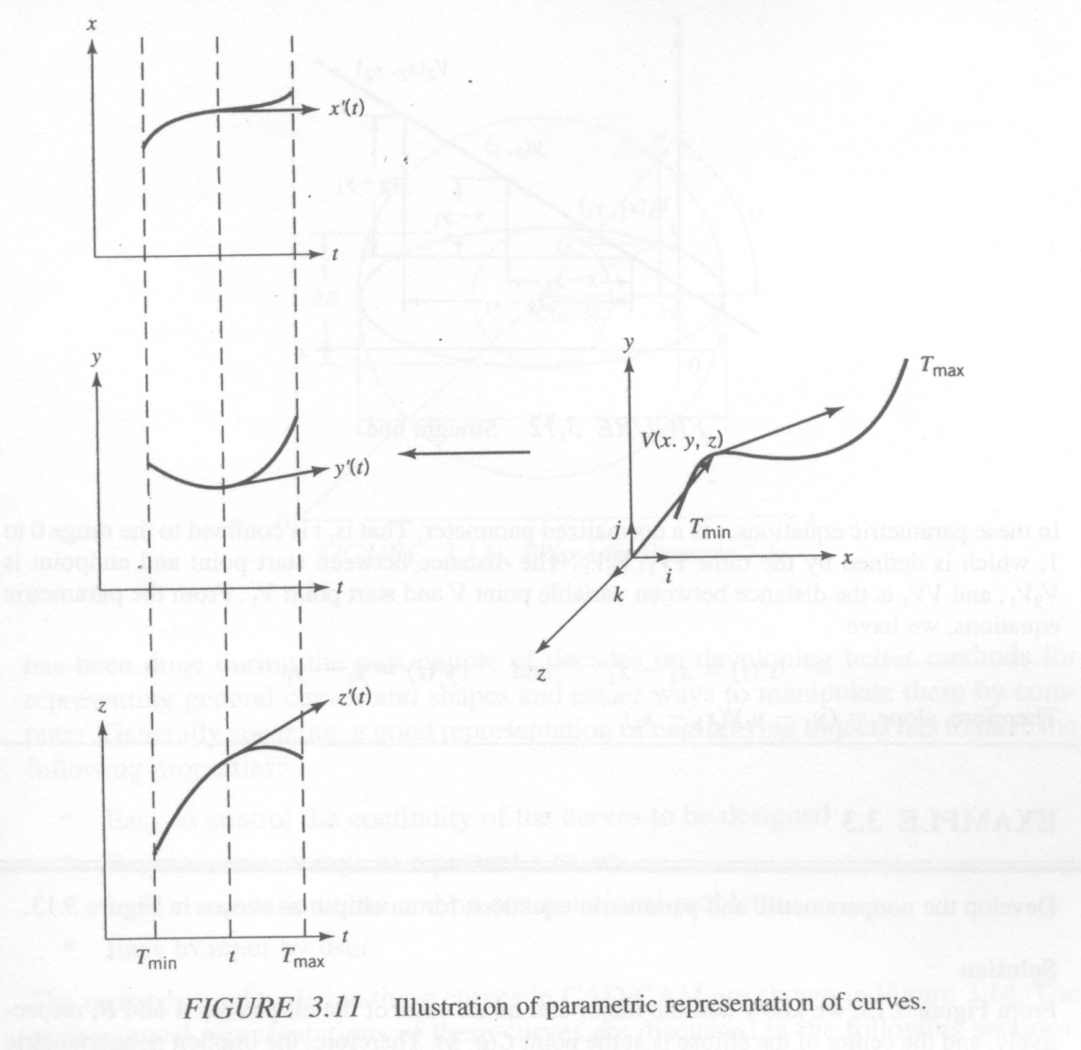
Non parametric representation (Implicit case)
The implicit non parametric representation of a general n-dimensional space curve takes the form:
This equation must b solved analytically to obtain the explicit form, which is not easily done by computer.

Slide 16
Parametric Representation of curves
Parametric representation of curves involves a parameter ‘t’ which is used to define x and y coordinates as:
x= X(t), y= Y(t), and z=Z(t).
The value of the parameter ‘t’ can be either bounded by the minimum (Tmin) and maximum (Tmax) range of the normalized range between 0 and 1.
The parameterization enables us to obtain the x, y, z coordinates of points on the curves by directly substituting the values of the parameter ‘t’.
The vector V(t) =[x,y,z]^{T} = [X(t), Y(t), Z(t)]^{T} , Tmin < t < Tmax
Where V(t) is the point vector and t is the parameter of the equation.
For example, for the curve given by V(t), we have
V’(t) = [X’(t), Y’(t), Z’(t)]^{T} , Tmin < t < Tmax

Slide 17
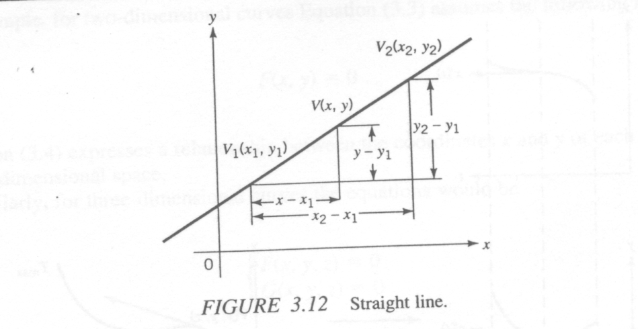
Example Problem
Develop the parametric line equations from non parametric equation of a line. Using resulting equations, find the slopes.

Slide 18
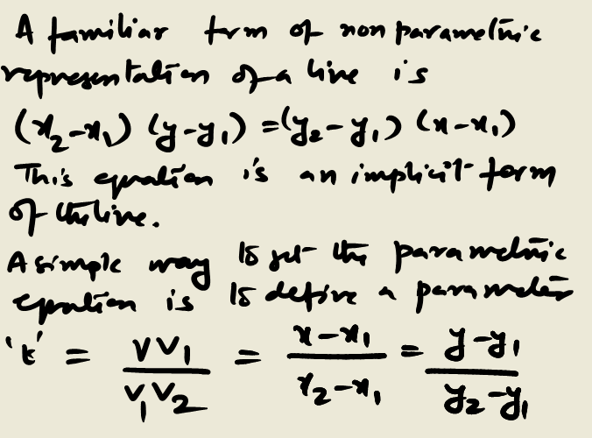
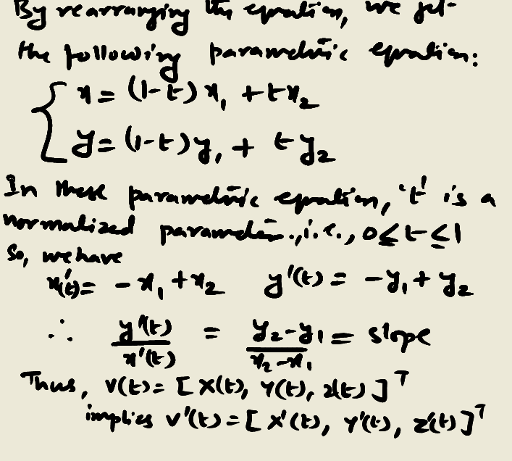
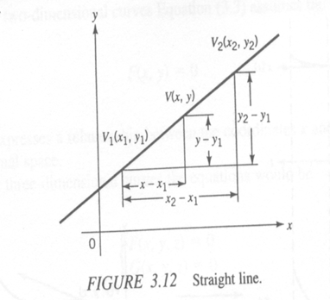
Solution

Slide 19
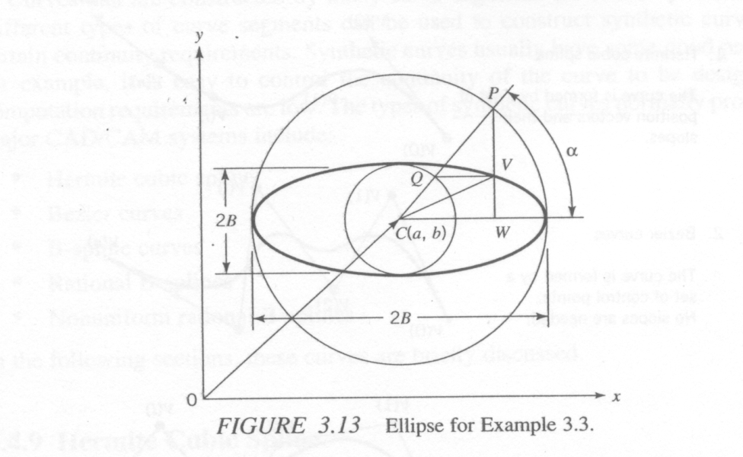
Example Problem
Develop the non parametric equation for the ellipse as shown in the figure on the left.
2A

Slide 20
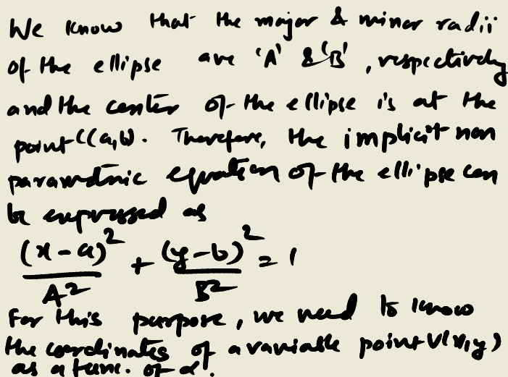
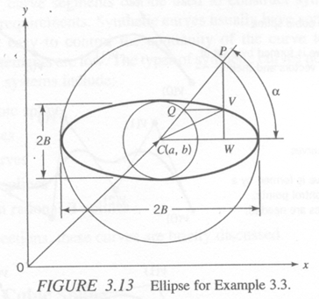
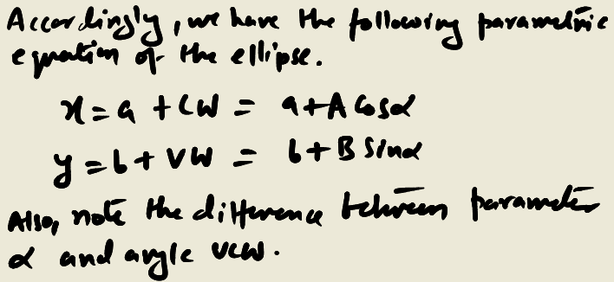
Solution

